Slide 1



Slide 2

VRChat Worldbuilding

Slide 3
Lego Land
Hairuo Sun, John Gagan, Taylor Hamilton, Madina Masimova

Slide 4
Lego Land: a collaborative workspace for creatives
The goal was to create interconnected islands where people from different disciplines, such as art, architecture, engineering, etc. could work separately on separate islands and then come together in the central island to collaborate.
This is what we did:
Created a Planning document
Researched Unity Asset Store for free worldbuilding assets
Created a GitHub repository for sharing files
Also shared files on Google Drive
Created models of chairs and tables in Blender
Created islands with pieces of island asset
Connected islands with corridor assets
Made objects grabbable using VRCpickup script

Slide 5
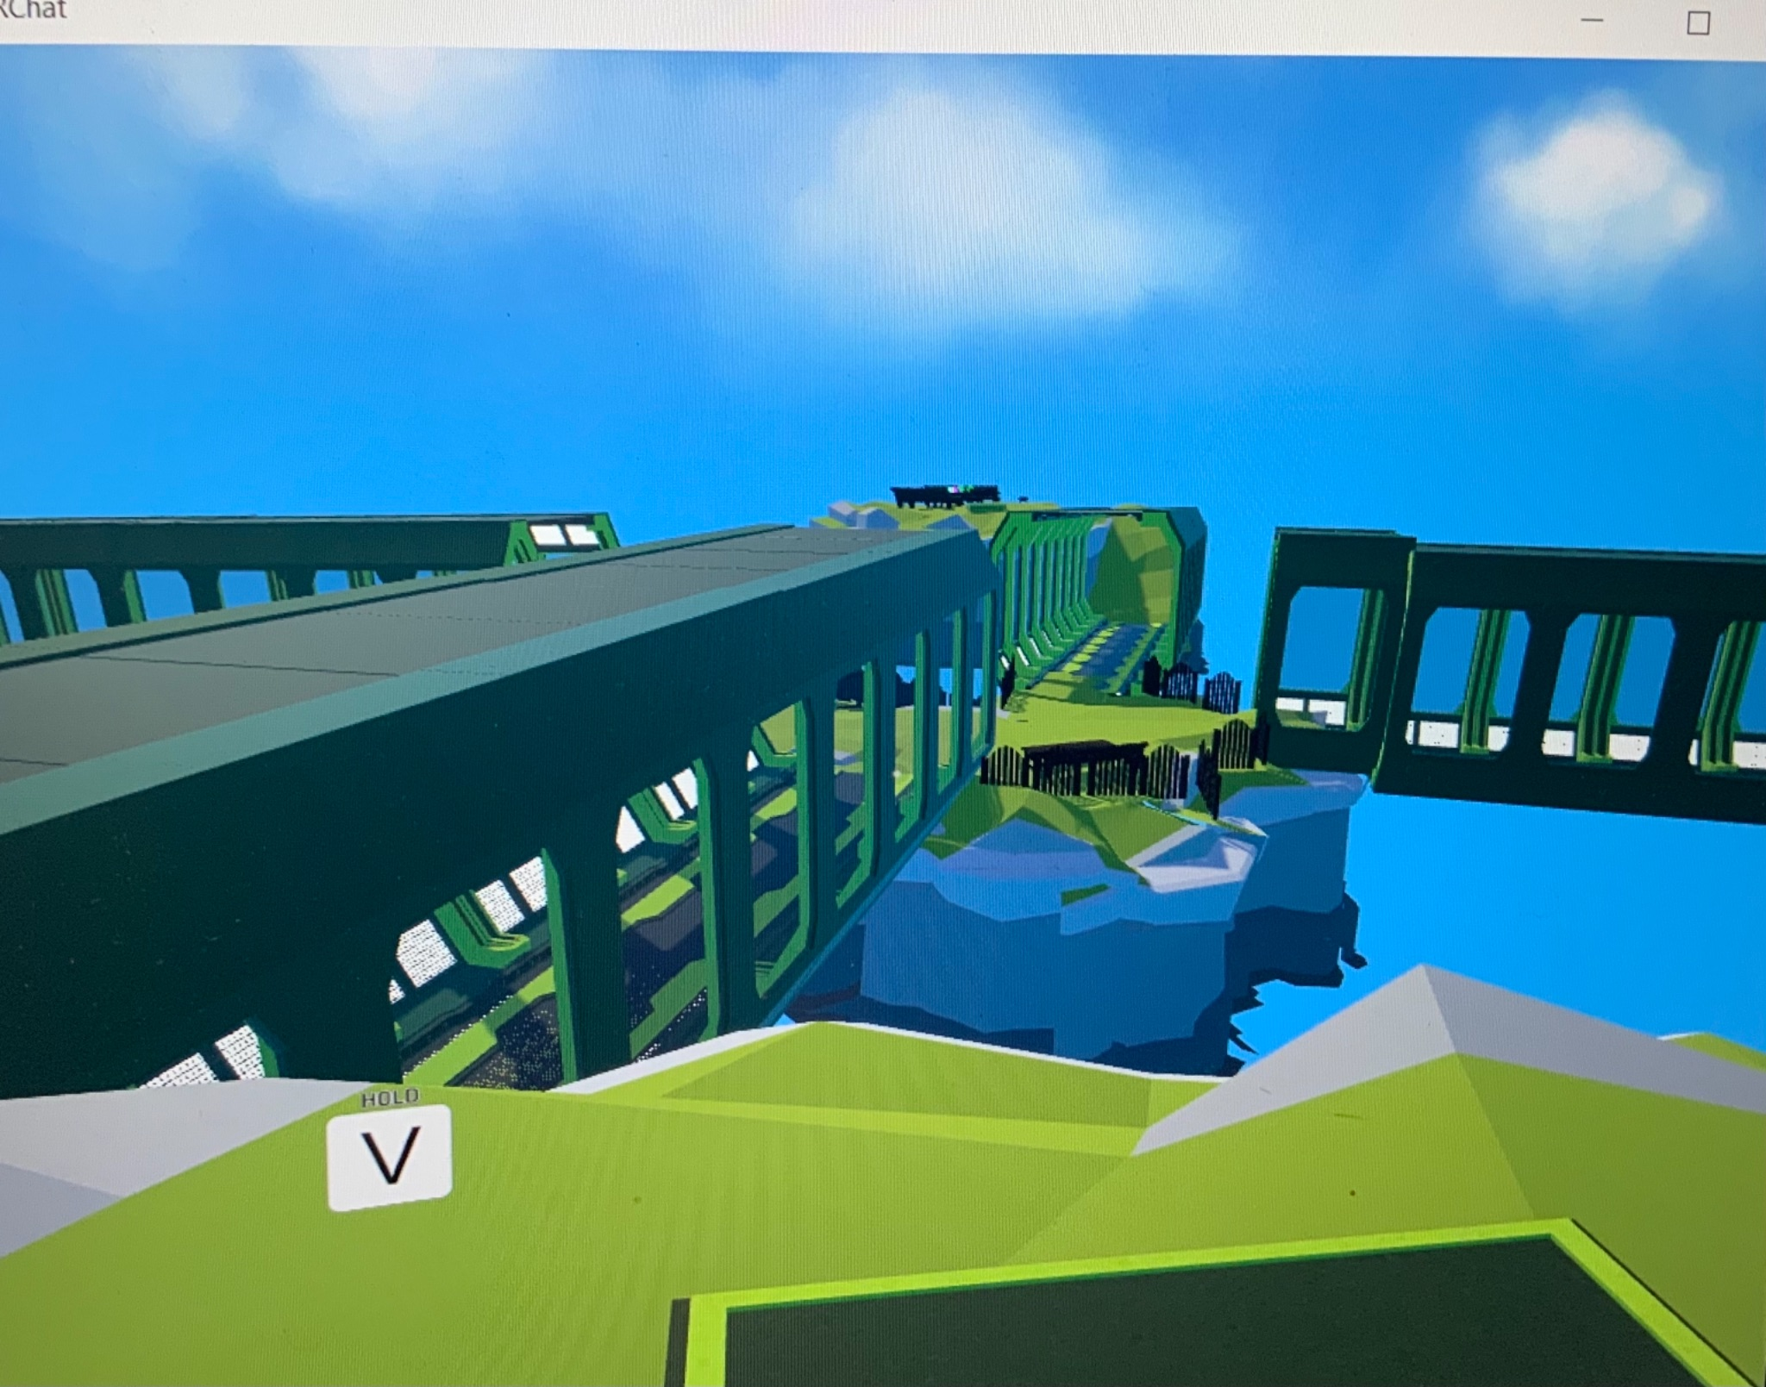
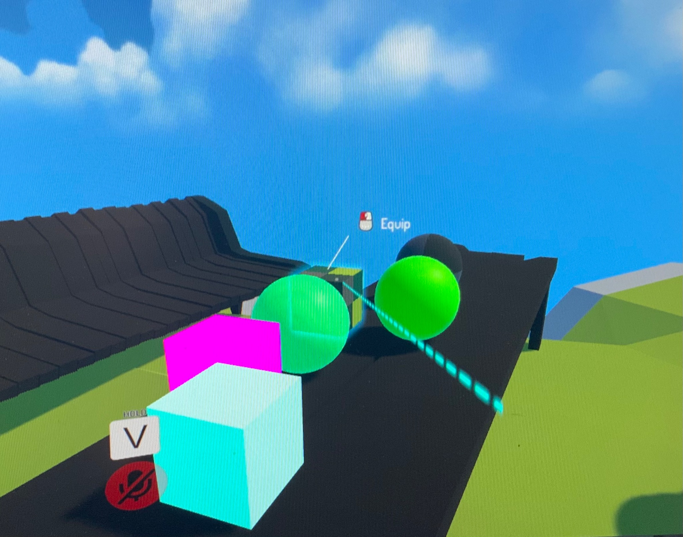
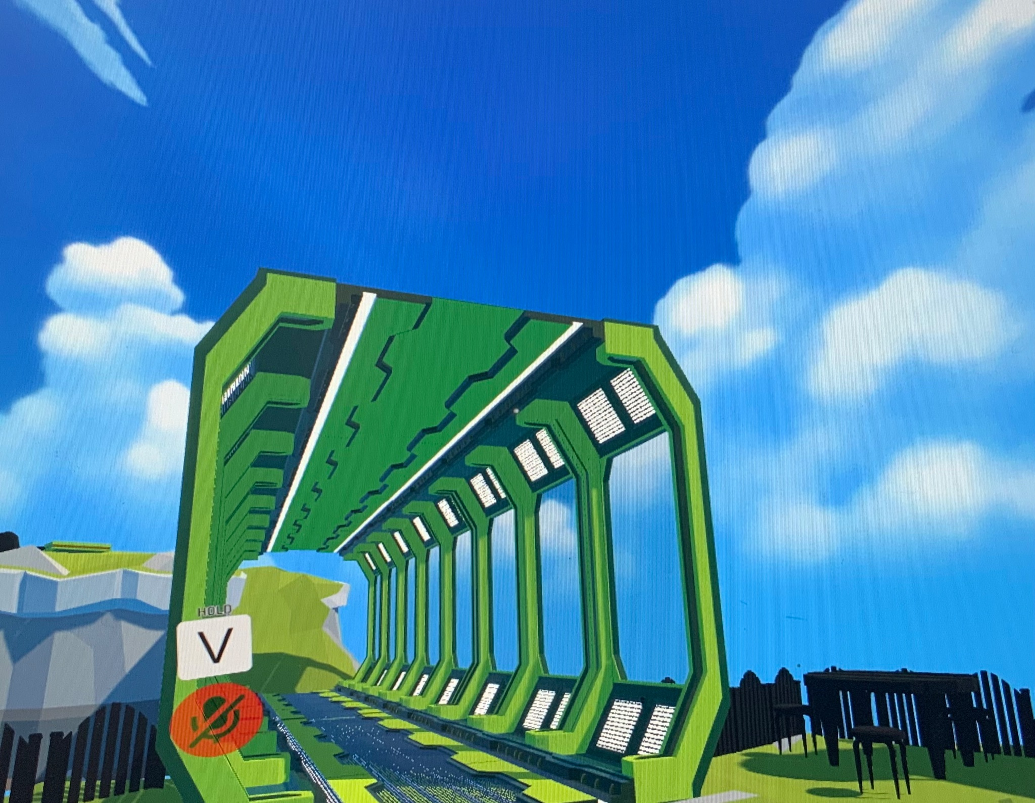
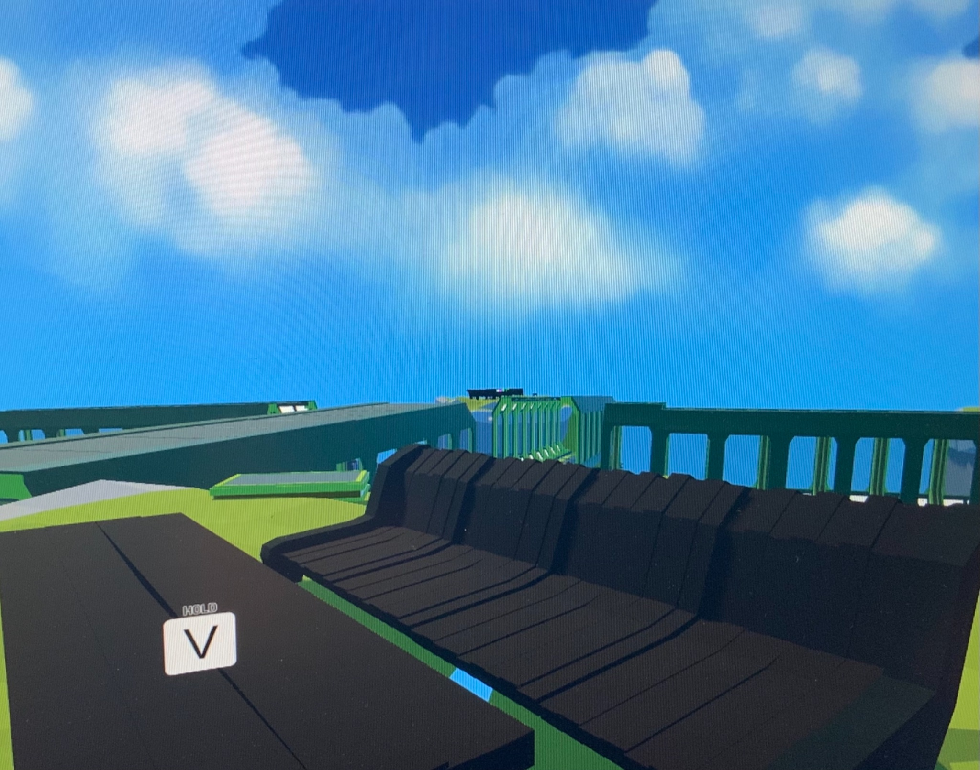
VRChat: Click HERE to Access Project Link

Slide 6
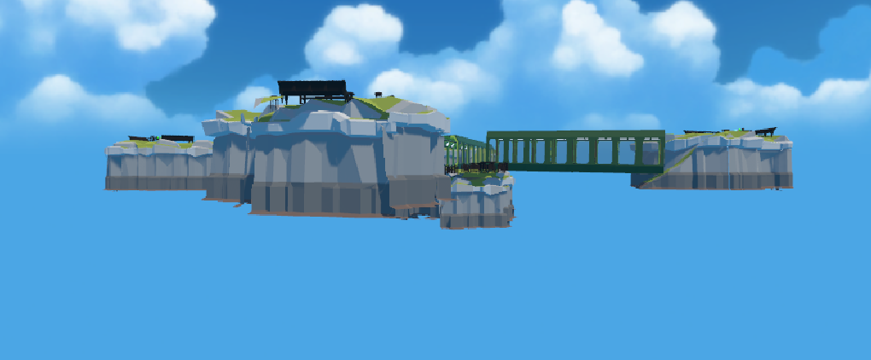
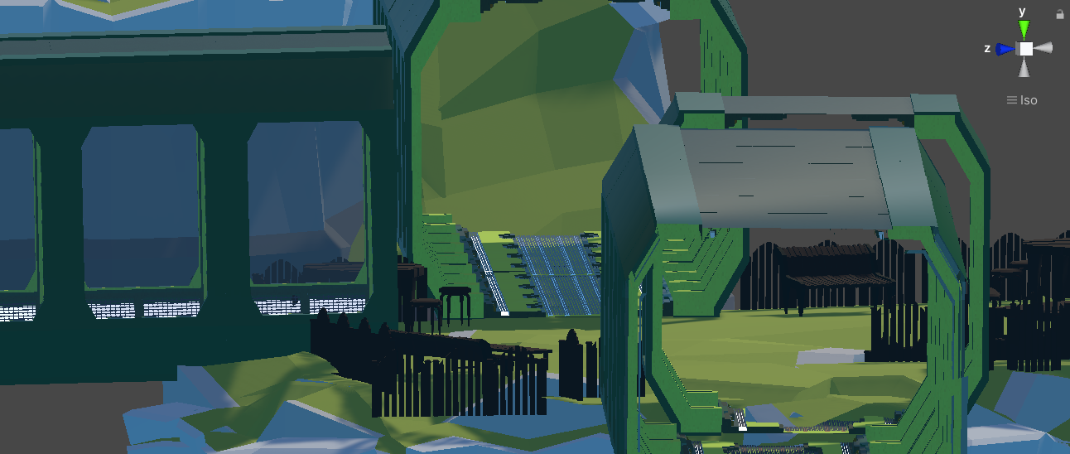
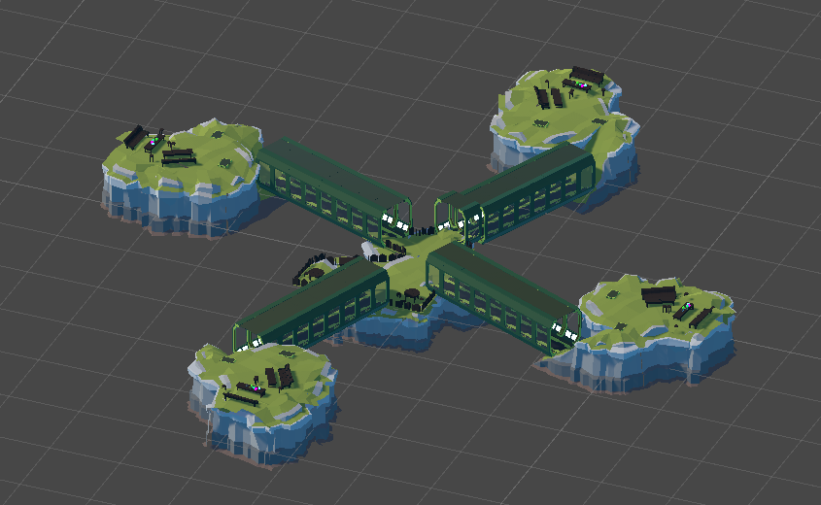
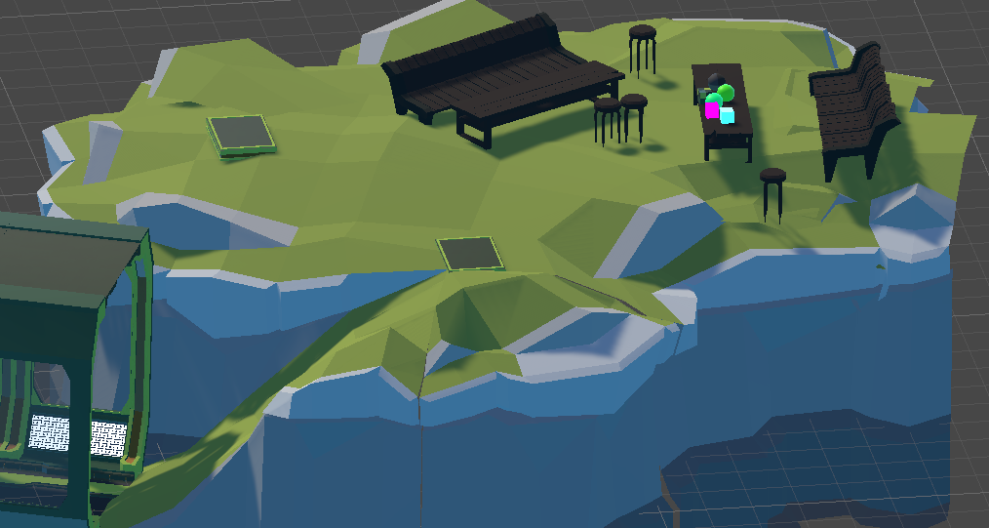
Unity Interface

Slide 7
Any Questions?

